Slide 1
The great india hackathon. Chitkara university.
PORTFOLIO WEBSITE WITH LOGIN/SIGNUP PAGE.

Slide 2
TECH STACK AND USE CASES
TECH STACK :
HTML
CSS
JS
MYSQL PHP
USE CASES :
Home
PTE
IELTS
Testimonials
Contact
Reviews Guide

Slide 3
FUNCTION OF USE CASES :
1. The HOME PAGE basically briefs us about what the website is all about.
2. The IELTS section and PTE will refer to a webpage which gives brief information
about both the exams and also tell about the course details.
3. The GUIDE SECTION will give an exposure on the variety of countries and the
colleges of the same.
4. CONTACT section will how you can contact them on the other side of the page.
5. REVIEW gives us a clear picture about the feedbacks of the people.
6. TESTIMONIALS tells us about the experience of the students and also
their performance and results. Also, it gives a contact request to contact
the excellent students of the institute for experiential guidance.

Slide 4
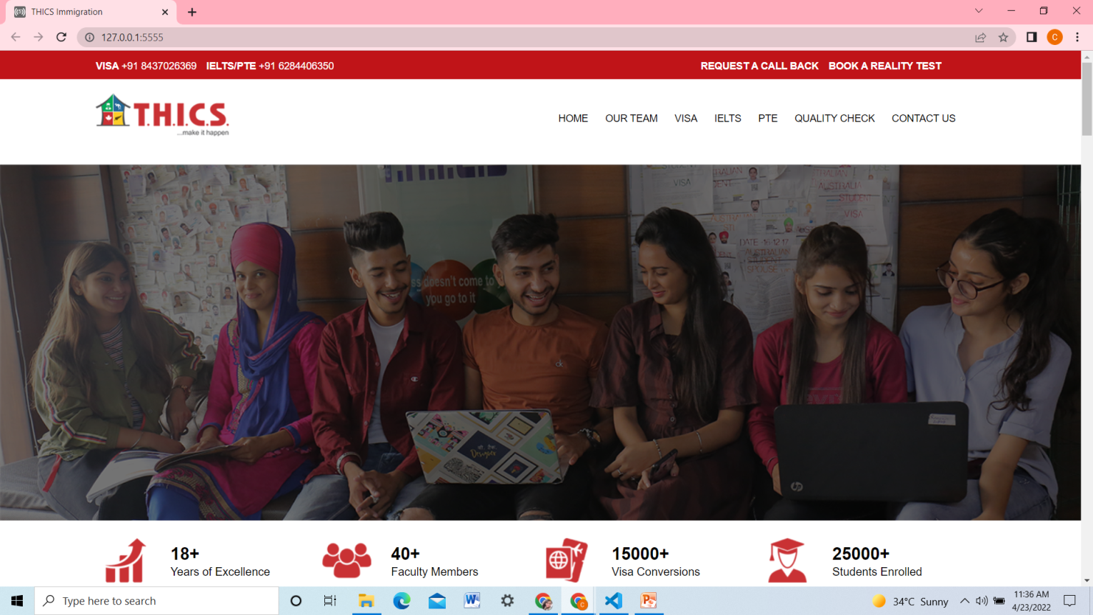
A glimpse of our website.

Slide 5
SUBMITTED BY: TEaM GROUNDBREAKING
TEAM MEMBER DETAILS:
Ishita Jindal
Chahat Batra
Asmi Garg

